Slide 1
COVID -19 prevention : Real-Time implementation of AI - Based face mask detection
Made By:
Sourav Dutta (11801258)
Subrojit Roy (11801400)
Course Code: CSE445
Group No: CSERGC0154

Slide 2
Abstract
The year 2020 has shown humanity an incredible variety of occasions among them COVID19 pandemic is the most dangerous change.
It surprised the world from the beginning of the year and affected the happiness and life of the masses.
COVID19 has called for serious measures to be taken to prevent the spread of the disease.
Cleanliness is an essential instruction for medication use in the emergency room, individuals give their best and public welfare; Face coverings are one of the personal defense equipment.
People cover their faces when they leave their house, also authorities strictly ensure that individuals wear a face mask when they are gathering in an open point.
To confirm that people are complying with these need of welfare rules, a method must be made. A face mask detection tool can be made to consider this.
Face mask identification means knowing whether an individual is wearing a mask or not.

Slide 3
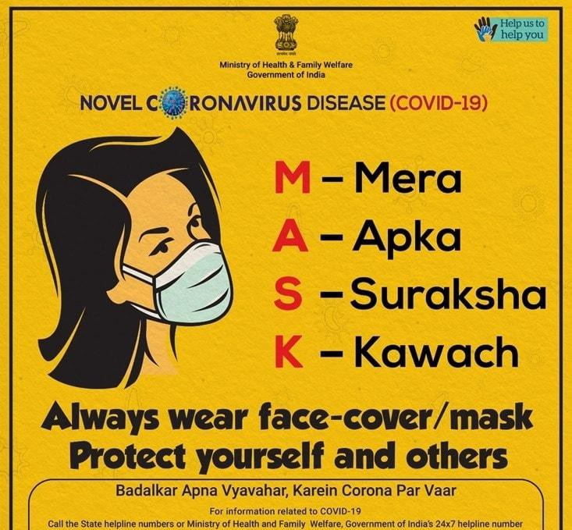

Slide 4
Face Mask detection
Artificial Intelligence is used by the Face Mask Detection Platform to check if a person is wearing a face mask or not.
To identify persons with or without a mask, the program may be connected to any present or new IP camera.
The picture capture with a camera is the first step in the face mask detection procedure.
The imaging gadget and modules were made utilizing TensorFlow and Open-CV programming to recognize the face and assess all points in order to check if a person is wearing a face mask or not.
On condition an individual wears a mask, they are within the secure zone, which shows up as a green rectangle-box with a secure caution, in any case in case, they do not, it shows up as a red rectangle-box with an alarm message.

Slide 5
Project Goal
The purpose of the project “Face Mask Detection Using Machine Learning” is to create a tool that identifies a person, or a group of people is wearing mask or not in the real-time. Due to COVID, wearing a face mask is must in order to stay safe. As the country starts going through various stages of reopening, face masks have become an important element of our daily lives to stay safe. Wearing face masks will be required in order to socialize or conduct business. So, this application utilizes a camera to stream live video and then pass it though the model to detect if a person is wearing a mask or not.

Slide 6
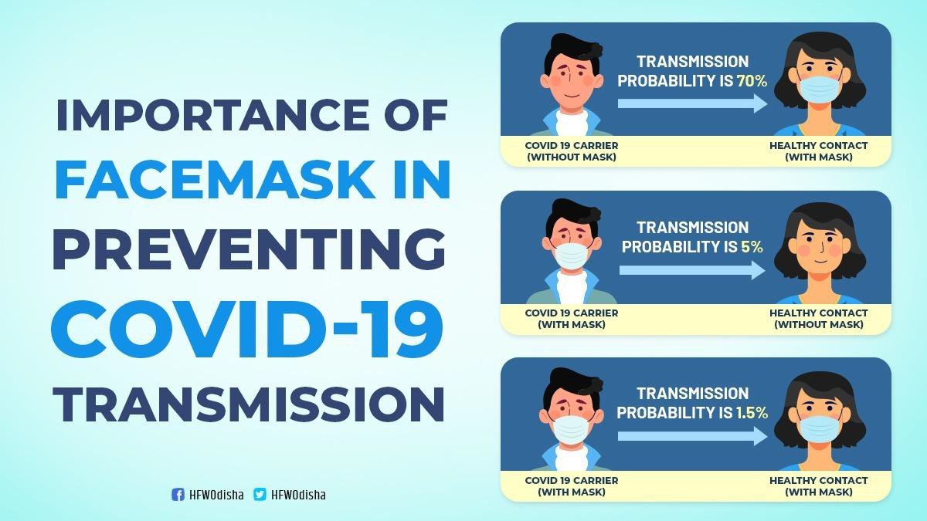

Slide 7
ADVANTAGES
Intelligent Alerts.
Facial Recognition.
Camera Agnostic.
Easy Implementation.
Staff Friendly.
No New Hardware Needed

Slide 8
disadvantages
“Lack of control over their personal information.” Critics of mask recognition also think that this new technology could be prone to some of the same pitfalls as facial recognition.
Many of the training datasets used for facial recognition are dominated by light-skinned individuals.

Slide 9
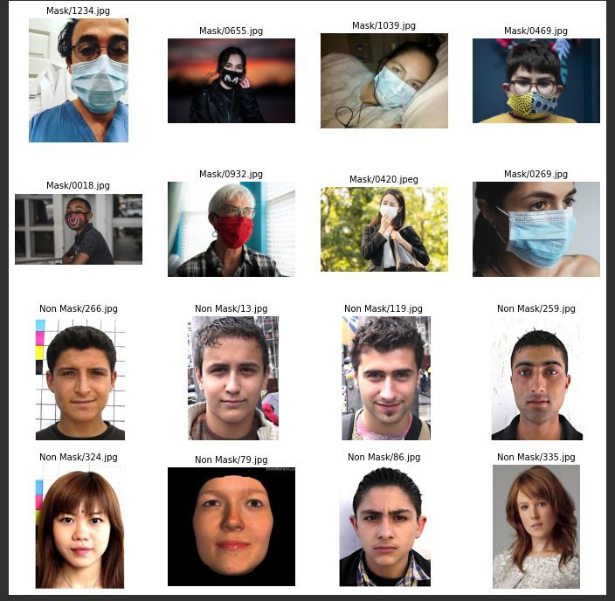
Images with Mask/No Mask

Slide 10
Deep Learning
Deep learning can be considered as a subset of machine learning. It is a ﬁeld that is based on learning and improving on its own by examining computer algorithms. While machine learning uses simpler concepts, deep learning works with artiﬁcial neural networks, which are designed to imitate how humans think and learn.
Until recently, neural networks were limited by computing power and thus were limited in complexity. However, advancements in Big Data analytics have permitted larger, sophisticated neural networks, allowing computers to observe, learn, and react to complex situations faster than humans.
Deep learning has aided image classiﬁcation, language translation, speech recognition. It can be used to solve any pattern recognition problem and without human intervention.

Slide 11
How Deep Learning works?
Neural Networks are layers of nodes, much like the human brain is made up of neurons. Nodes within individual layers are connected to adjacent layers. The network is said to be deeper based on the number of layers it has.
A single neuron in the human brain receives thousands of signals from other neurons. In an artiﬁcial neural network, signals travel between nodes and assign corresponding weights. A heavier weighted node will exert more effect on the next layer of nodes. The ﬁnal layer compiles the weighted inputs to produce an output.
Deep learning systems require powerful hardware because they have a large amount of data being processed and involves several complex mathematical calculations. Even with such advanced hardware, however, deep learning training computations can take weeks.

Slide 12
Cont.
Deep learning systems require large amounts of data to return accurate results; accordingly, information is fed as huge data sets. When processing the data, artiﬁcial neural networks are able to classify data with the answers received from a series of binary true or false questions involving highly complex mathematical calculations.
For example, a facial recognition program works by learning to detect and recognize edges and lines of faces, then more signiﬁcant parts of the faces, and ﬁnally, the overall representations of faces. Over time, the program trains itself, and the probability of correct answers increases. In this case, the facial recognition program will accurately identify faces with time.

Slide 13
Limitations of deep learning
Deep learning requires large amounts of data. Furthermore, the more powerful and accurate models will need more parameters, which, in turn, require more data.
Once trained, deep learning models become inﬂexible and cannot handle multitasking. They can deliver eﬃcient and accurate solutions but only to one speciﬁc problem. Even solving a similar problem would require retraining the system.
Any application that requires reasoning - such as programming or applying the scientiﬁc method-long-term planning and algorithm like data manipulation is completely beyond what current deep learning techniques can do, even with large data.

Slide 14
Computer Vision
Computer vision is an intriguing scientific subject that reflects how computers can recognize digital images and recordings at a high level.
Computer vision tasks include strategies for protecting, handling, investigating, and understanding digital images, as well as strategies for extracting numerical and symbolic information from high-dimensional data in the actual world.

Slide 15
Convolutional Neural Network (CNN)
Convolutional neural network (CNN or ConvNet) is a deep neural network most used to analyze visual images. They are also known as change- invariant or spatially invariant artificial neural networks (SIANN) based on weight-sharing architecture of convolution kernels that slides on the input features and provide an equivalent translation response called a feature maps.
Counter-intuitively, most convolutional neural networks are only equivariant, as opposed to invariant, to translation. They are used in image and video recognition, recommender systems, image classification, image segmentation, medical image analysis, natural language processing, brain-computer, financial time series and interfaces.

Slide 16
Working of the System

Slide 17
Pre-processing of images
Before using face detection and matching algorithms, the input picture must be pre-processed. Noise reduction, eye and mask dentification, and hole filling procedures are all part of the pre-processing process.
Noise reduction and hole filling assist to eliminate erroneous face/face detection.
The facial picture is cropped and re-localized after pre-processing.
To increase the quality of the pre-processed image, histogram normalization is used.
We employed Convolutional Neural Networks in this article, hence the dataset pictures were downsized to 224*224-pixel resolution.
Following resizing, the photos were pixelized (that is, transformed into an array) using OpenCV library methods.
With TensorFlow and Keras library functions, the pictures are labelled as 'with mask' or 'without mask' after they have been pixelized. For training, a master array comprising all pixelized pictures with labels was created.

Slide 18
Training of the model
The Convolutional Neural Network, i.e., MobileNetV2 is used in the last phase of training the model. Both models were given identical parameters for training. The dataset has been separated into two parts: 80 percent for training and 20% for validation. Both models employ accuracy metrics to validate the data, as it evaluates the model after each epoch. In this study, we utilized photographs with a batch size of 32 and input sizes of 224*224 as width and height, respectively for the CNN model. After testing, the parameters for the ADAM optimizer were adjusted based on the accuracy, which was found to be optimum at 20 epochs and a learning rate of 1e-4. As a result, the Image Data Generator is used to expand the dataset by rotating, rescaling, zooming, and flipping the photos. Because picture resolutions are lowered when features are extracted, the dropout rate for both models is set at 50 to avoid overfitting.

Slide 19
Training and loss Accuracy
Epochs Accuracy
5 98.06
10 99.22
15 99.35
20 99.81

Slide 20
OUTPUT
Fig 1. Where Sourav is not wearing a mask
Fig 2. Where Sourav is wearing a mask

Slide 21
Cont.

Slide 22
CONCLUSION AND FUTURE ENHANCEMENT
Conclusion: Wearing a face mask all the time is a demanding and tedious duty, but it has been mandatory since the Covid-19 crisis since wearing a face mask can help restrict the virus's spread. Some public service providers require customers to wear masks in order to be able to provide services at the beginning of this paper, we briefly talked about the work's inspiration. The model's learning and execution tasks were at that point illustrated. The strategy has achieved a sensible level of precision by utilizing fundamental machine learning tools and disentangled strategies.
Future Enhancement: In the future, the model can be extended to determine if a person wears the mask correctly (recommended by WHO) and the type of mask. This trained model can be used in public places using an IP camera to detect if a person is wearing a mask and is a valuable tool in the fight against the COVID 19 virus. We can utilize another source of information for future investigation. This model may be integrated with an alarm system, a social distancing system, and an SMS alert system. This model may also be evaluated with various optimizers and adaptive learning approaches can be used.

Slide 23
THANK YOU!

